Slide 1
Wireless Lighting System
Project 2

Slide 2
Project Description
This project aims at designing and implementing a Wireless Lighting System by which an LED (or bulb) is being controlled using an IR remote.
The project uses the IR receiver to demodulate or decode the IR signals from the IR remote, the signals (keys) are then printed on the serial monitor to show the pressed key.

Slide 3
Components involved
Arduino UNO R3 Board
IR remote
IR Receiver sensor
Jumpers and connecting wires
LED
Breadboard (for prototyping)
Resistor

Slide 4
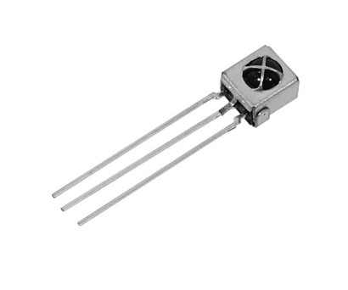
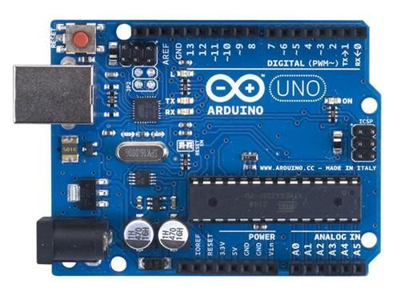

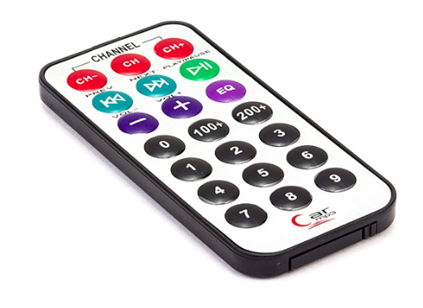
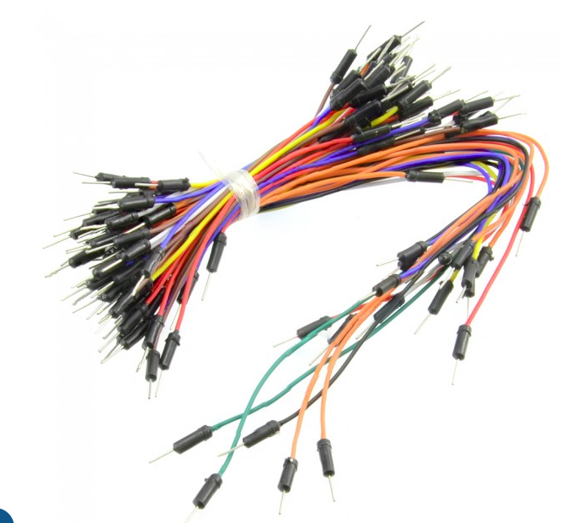
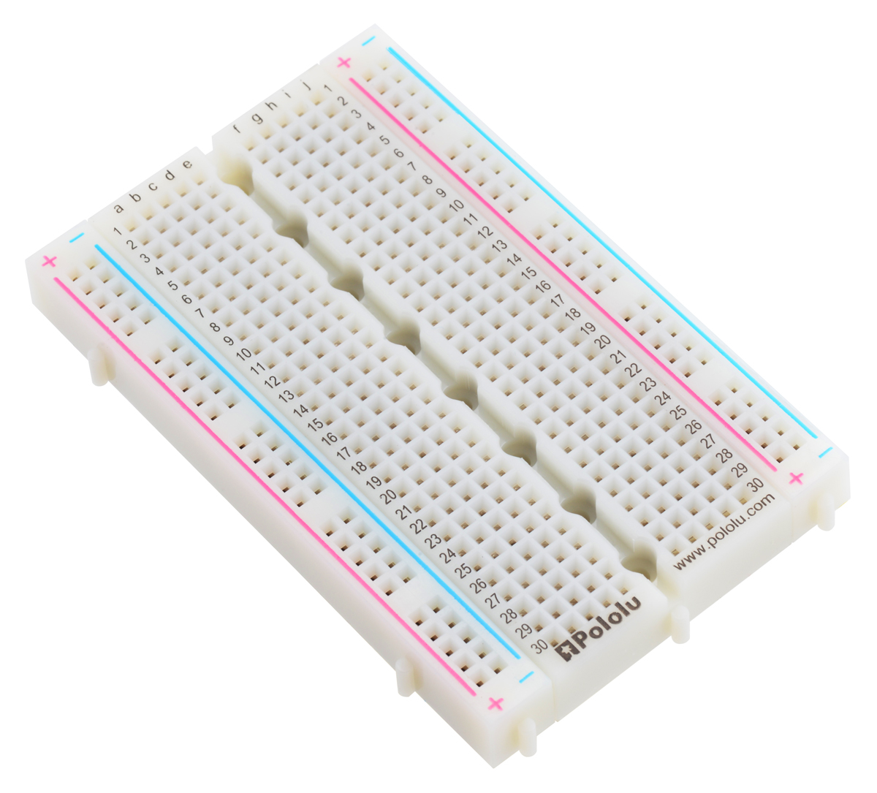
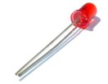
IR Receiver sensor
220 ohms
Arduino UNO R3 board
IR Remote
Light Emitting Diode (LED)
Jumpers
Breadboard

Slide 5
Working Principle of IR Receiver Sensor
IR Receiver is also called a photodiode.
The emitter is an IR LED and the detector is an IR photodiode.
The IR photodiode is sensitive to the IR light emitted by an IR LED. The photodiode's resistance and output voltage change in proportion to the IR light received.
IR receivers are specially filtered for IR light, they are not good at detecting visible light.
They have a demodulator that looks for modulated IR at 38kHz. Just shining an IR LED won't be detected, it has to be PWM blinking at 38kHZ.

Slide 6
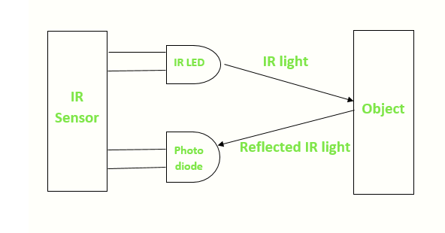
The Working of an IR Receiver

Slide 7
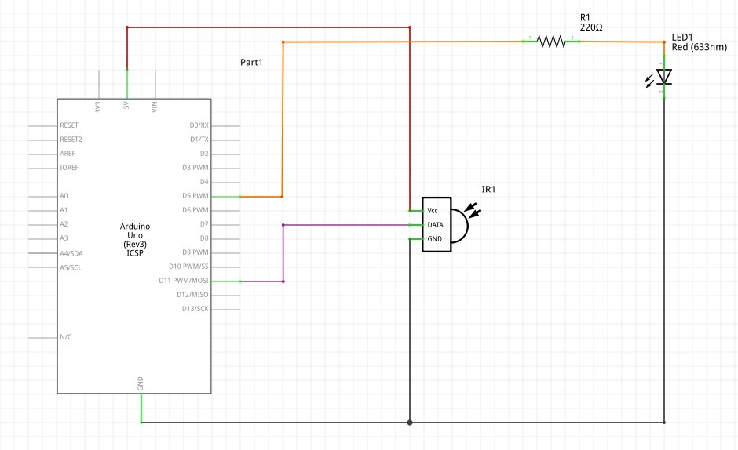
Schematic Circuit

Slide 8
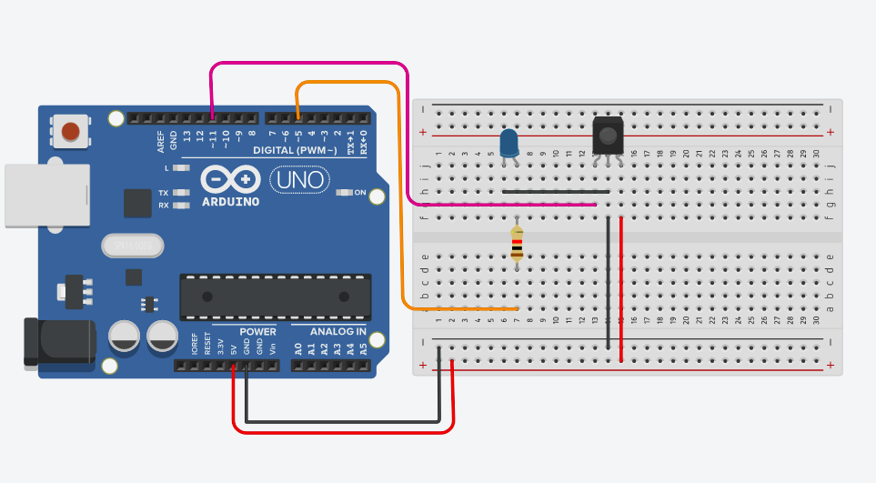
Breadboard Circuit

Slide 9
Applications of the Project
Smart homes and Offices
Hospitals
Underground Mining
With Complex wiring
In Wooden homes

Slide 10


